Slide 1

Team Name: Prolific Coderz State: Tamil Nadu College Name: SSN College of Engineering

Slide 2
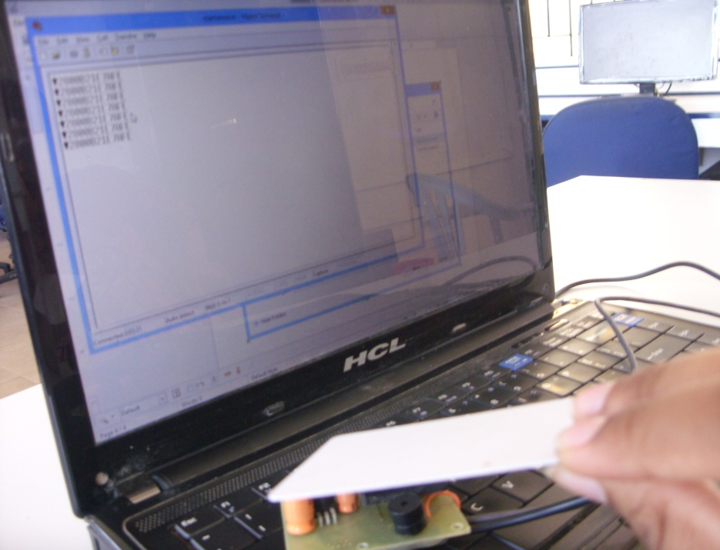
UNIVERSAL STUDENT IDENTIFICATION USING RFID
A PROJECT BY
ANANTHA NITHYA A
ANJANA S
ARUNA S
NIRNIKA L
UNDER THE GUIDANCE OF Ms ANGEL DEBORAH
CSE DEPARTMENT,
SSN COLLEGE OF ENGINEERING, Chennai

Slide 3
About the Team
Aruna – Attendance Marking, Automatic Email/SMS
Anjana – Internal Mark Calculation, User Interface Design, Admin Functionalities
Anantha Nithya – Report Generation, Internationalization
Nirnika – Integration of Modules, Documentation

Slide 4
WHAT WE DID?
The basic idea behind the project is to provide fool-proof attendance marking for students in a university using RFID.
We have developed a system that supports swiping RFID tags while entering and leaving the class. Only when a card is swiped during both the InEntry and OutEntry session, the attendance is given for the student for that period. We have to connect the RFID kit to the computer using PuTTY application after installing the necessary driver software. Once connected, the text has to be captured to two files (one for InEntry and one for OutEntry). Text from these files will be read at the end of the InEntry and OutEntry sessions.

Slide 5
WHAT WE DID?
Our application provides internal mark calculations by taking average of all unit test marks till date and adding the marks for attendance based on the attendance percent for the semester.
We have also used Jasper API to view and download reports. Parents and students can view reports in HTML and PDF forms.
In addition, the Admin can send automatic Emails to parents notifying them the performance reports that have been published.
Intimation about events like ‘holidays’, ‘special classes’ etc can be done by automatic SMS feature which is controlled by the Admin.

Slide 6
WHAT WE DID ?
Chat rooms have been provided for interaction among students.
Admin functionalities include enrolling a batch of students for a course; enrolling a single student for a course; allotting a teacher to a course; adding a new student/faculty/course. AJAX has been used for forms.
Parents can login and view their child’s performance report for any month.
Regular Expression Validation has been done for forms.
Support for the website in Tamil, Telugu has also been done.

Slide 7
TOOLS & TECHNOLOGIES
Tools Used
Database used: DB2 Express-C
Server used: WebSphere Application Server Community Edition v8.5
IDE used: NetBeans 7.3, Eclipse Helios and RAD
For modeling : RSA
Operating System used for Development : Windows 7, Windows 8, Fedora 17
Technologies Used
JSP - JavaBeans
HTML 5 / CSS - AJAX
Servlets - JavaScript

Slide 8
SCOPE
This application helps to maintain a time-saving, fool-proof method of attendance-marking. It would make the faculty’s job easier as he/she can automatically calculate the Internal Marks for the semester.
In future, the application can be extended to :
* Automated Library System
* Automated Computer Labs
* Using biometric identification (like finger-print scanning)
* Including a portal for Alumni
* Create customized websites for each department
* Developing an Employee Management System for issuing salaries for faculty and other staff.

Slide 9
User Feedback
When we showed this project to our OOAD(Object Oriented Analysis and Design) teacher, she loved the interface and thought it was really professional. She was happy that we took the trouble to do realistic RFID interfacing. Also, providing support for SMS, Chat room and Emails was very much appreciated. She gave us some test cases (like validating session value to be a single digit as we cannot practically have 10 or more sessions in a day!) which we have implemented now.

